Slide 1
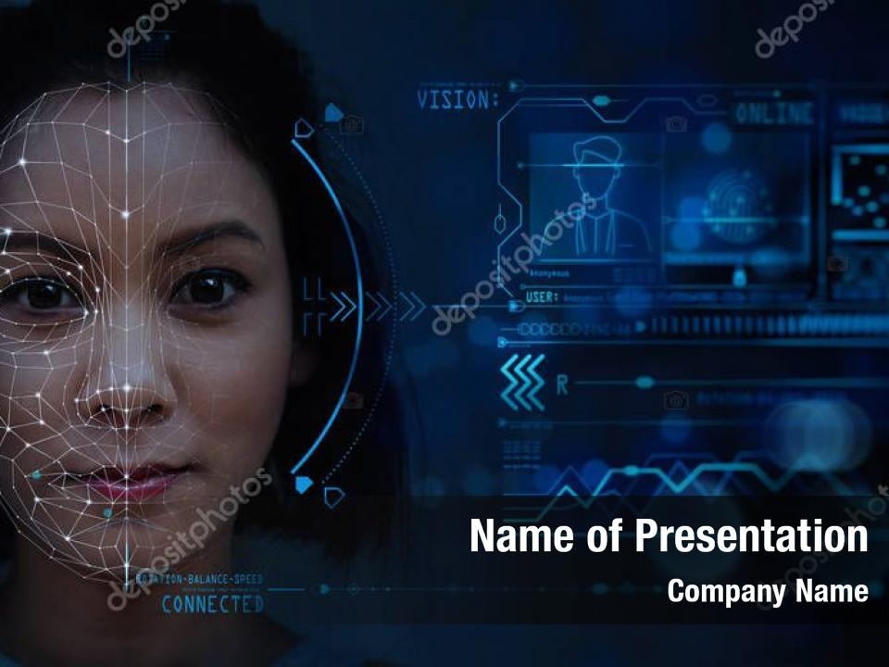
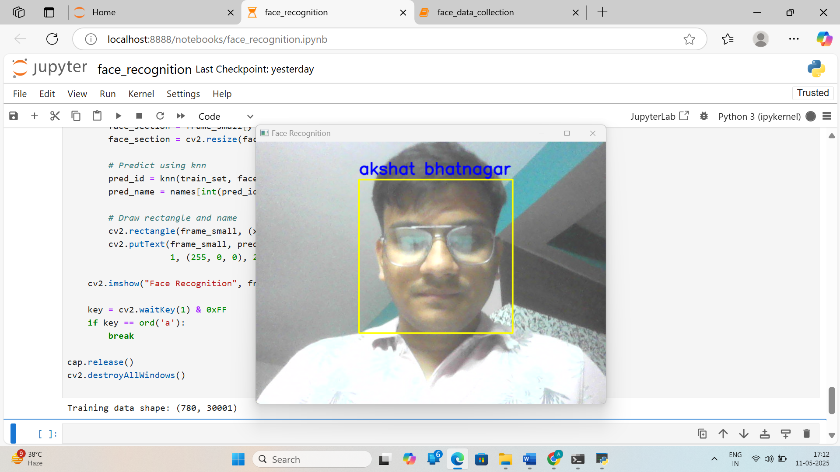
FACE RECOGNITION
SUBMITTED BY- AKSHAT BHATNAGAR
ROLL NO- 22BCON737

Slide 2

INTRODUCTION
USE CASE
FACE DATA COLLECTION
FACE RECOGNITION
PRETRAINED HAAR CASCADE (.XML) MODEL
MACHINE LEARNING ALGORITHM
SOFTWARE REQUIREMENT
SOFTWARE DESIGN
FUTURE ENHANCEMENT
CONCLUSION
CONTEXT

Slide 3
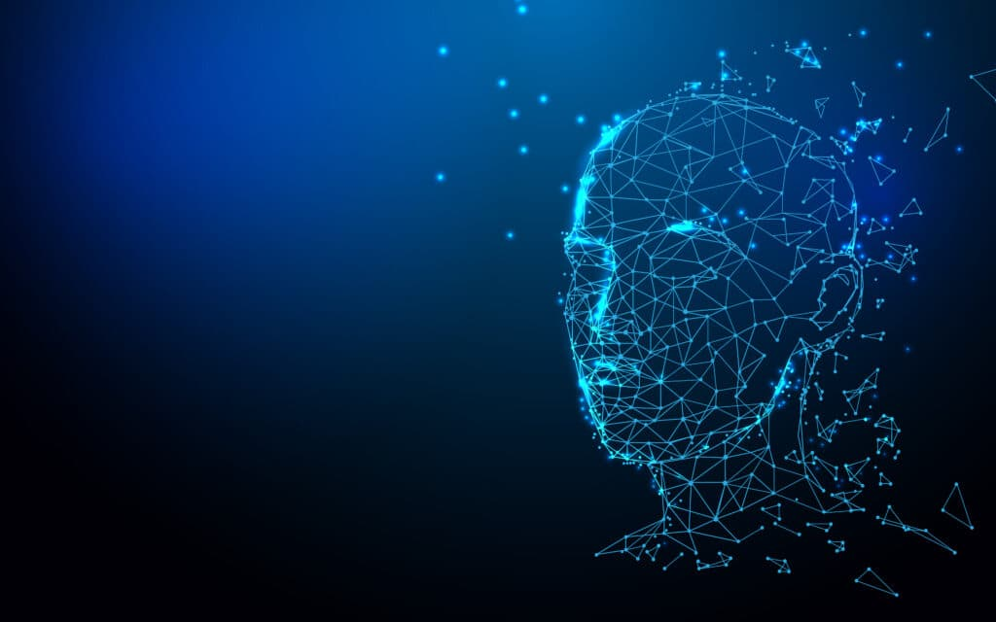
INTRODUCTION
The Face Recognition is a Python-based application that demonstrates how to implement a basic but effective facial recognition system using open-source tools.
It focuses on recognizing and labeling human faces in real-time video streams by leveraging machine learning, computer vision, and deep learning techniques.

Slide 4

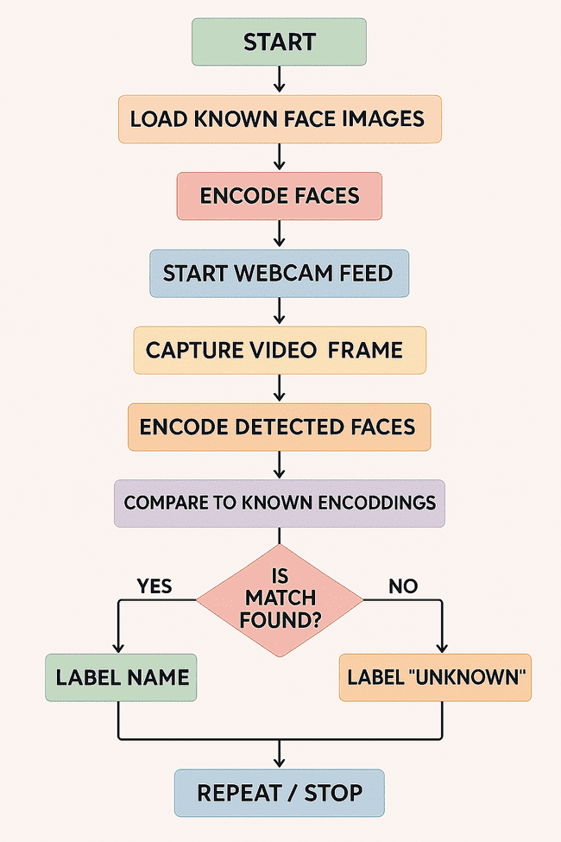
SOFTWARE DESIGN

Slide 5

HOW FACE RECOGNITION???
FACE DATA COLLECTION
FACE RECONITION USING KNN MODEL
PRETRAIN MODEL HAAR CASCADE
MACHINE LEARNING KNN MODEL

Slide 6
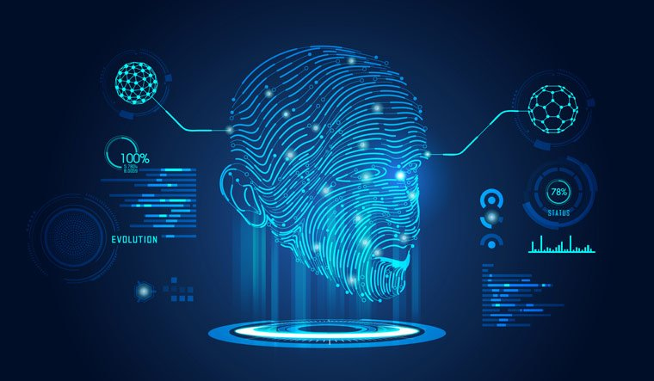
FACE DATA COLLECTION
EXECUTE PROGRAM
GIVE NAME DATA
COLLECTING FACE DATA
QUIT CAM BY ‘a’ KEY

Slide 7

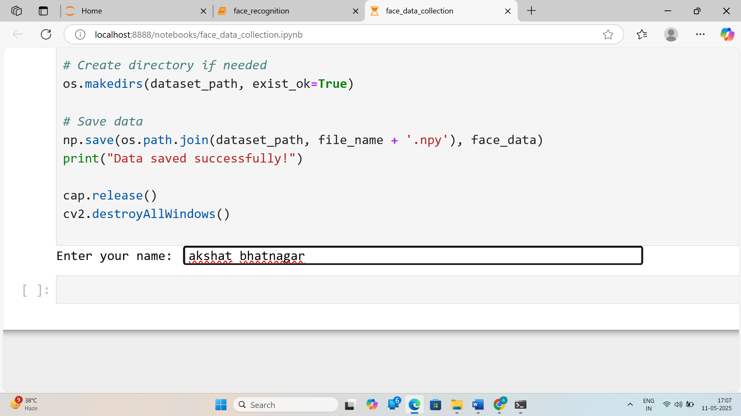
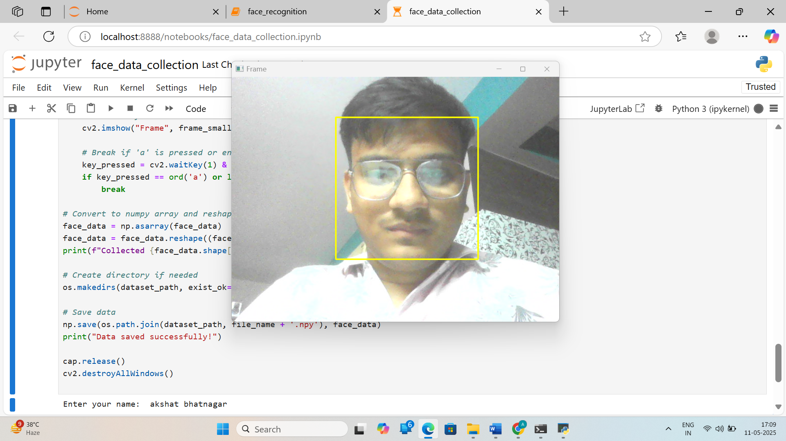
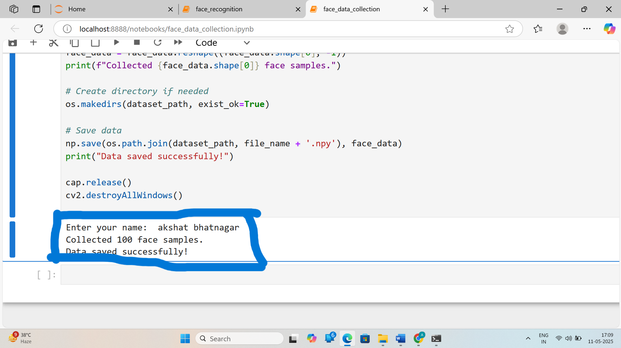





FACE DATA COLLECTION

Slide 8
FACE RECOGNITION
OPEN CAM
DETECT FACE BY STORED DATA
SHOW NAME OF THE PERSON
QUIT CAM BY PRESS ‘a’

Slide 9
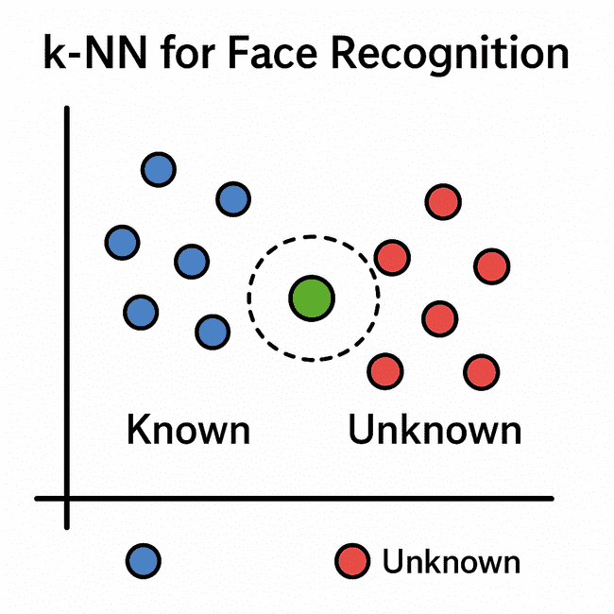
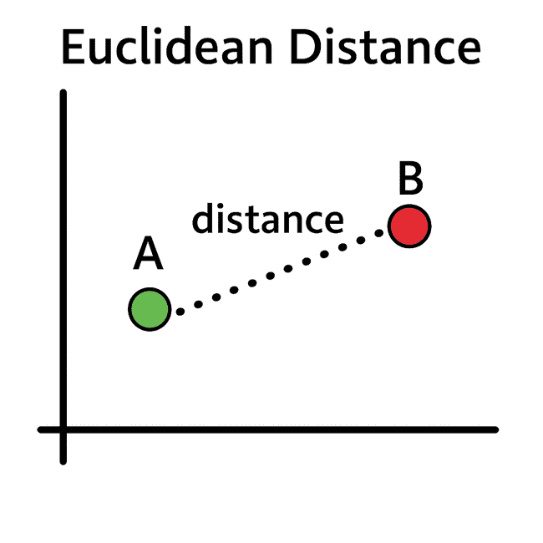
ML-KNN ALGORITHM
The algorithm calculates the distance between the newly detected face and all known faces using Euclidean distance.
It selects the K closest matches (neighbors) based on the smallest distances.
If a majority of neighbors belong to a known person, the face is classified accordingly.
If the distance exceeds a similarity threshold, the face is labeled as "Unknown."

Slide 10
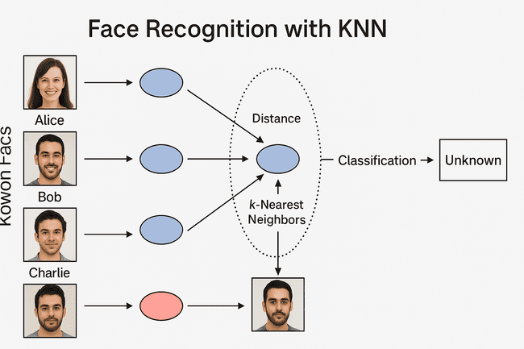

Slide 11

PRETRAINED MODEL HAAR CASCADE
It contains trained data for detecting frontal human faces.
When used in OpenCV’s CascadeClassifier, it scans the image at multiple scales to find patterns that match the characteristics of a human face.
It is efficient and suitable for real-time applications because it uses a cascade of increasingly complex classifiers
Used in both the data collection and recognition notebooks to detect face regions before processing.
Serves as the foundation for capturing and focusing on face areas, rather than processing the entire image.

Slide 12
USE CASES
Automated Attendance Systems
Face-BasedLogin/Authentication
USE CASE
Surveillance and Security Monitoring
Smart Access Control Systems
Identity Verification in Sensitive Transactions

Slide 13
PYTHON
HTML
CSS
SOFTWARE REQUIREMENT
ML-KNN ALGO
HEAVY GPU
OPENCV,COMPUTER VISON,NUMPY

Slide 14
🖥️GUI integration
🗄️ Database Integration
🛡️ Liveness Detection
🧠 Advanced Deep Learning Models
😷 Face Mask Detection & Demographics
☁️ Cloud Integration
FUTURE ENHANCEMENT

Slide 15
CONCLUSION
1) The Face Recognition system offers a real-time solution for identifying individuals via webcam input.
2) Developed using Python and key libraries: face_recognition, OpenCV, and NumPy.
3) Accurately detects, encodes, and recognizes faces by comparing them with a known dataset.
4) Performs reliably under standard lighting conditions.
5) Provides instant visual feedback using bounding boxes and labels on the video feed.
6) Modular design allows for easy addition of new faces to the system.
7) Can be adapted for various applications such as:
Biometric login systems
Attendance management
Security surveillance
8) Demonstrates how computer vision and machine learning can be used to solve real-world identity verification problems in a lightweight, cost-effective manner.

